Slide 1
Lesson 4
基础听力
雅思听力组

Slide 2
地图题

Slide 3
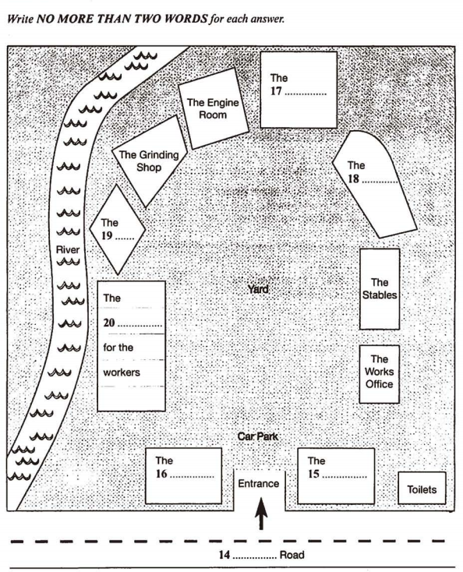
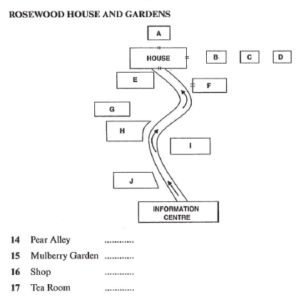
考点与分类
考点-- 针对街区或道路描述，对于地点名称进行匹配或填写
填空式
配对式

Slide 4
室内建筑地图

Slide 5

C11-T4-S2 P83
Basement of Museum

Slide 6

地图题黄金三要素—S D L
Skill
Starting Point
eg. entrance; reception; entry gate ...
Direction
eg. top; right; south; north ...
Landmark
eg. car park; lake; river ...

Slide 7
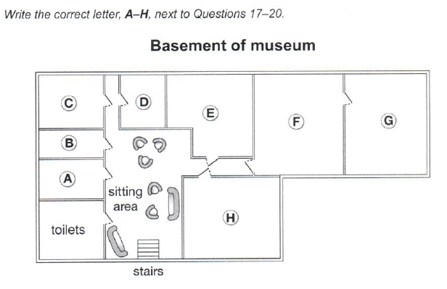

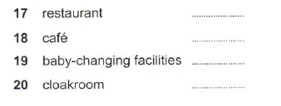
C11-T4-S2 P83
1看（SDL）
2听(方位词+地标)
3查
T
R
far side
turn right into the corridor
you’ll see the door of the resaurant facing you
cross the sitting area
contrinue stright the corridor on the left
it’s through the last door before you reach the corridor
L
B

Slide 8
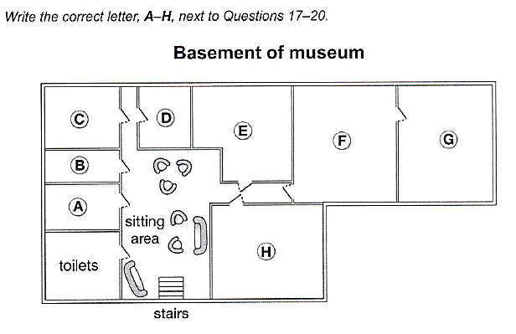
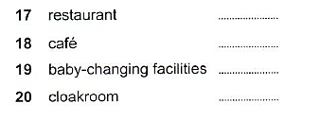
F
bottom，go straight ahead, turn right, corridor, facing
H
bottom，go straight ahead, turn right, right
C
cross the sitting area, corridor, left-hand side
B
left-hand side of corridor, last door before the corridor

Slide 9

C11-T4-S2 P83
corridor
暗线地标
L
L
R
R
无坐标时，前后左右方向以speaker的前进方向为准

Slide 10

Notes
go straight
bottom
cloakroom
corridor

Slide 11
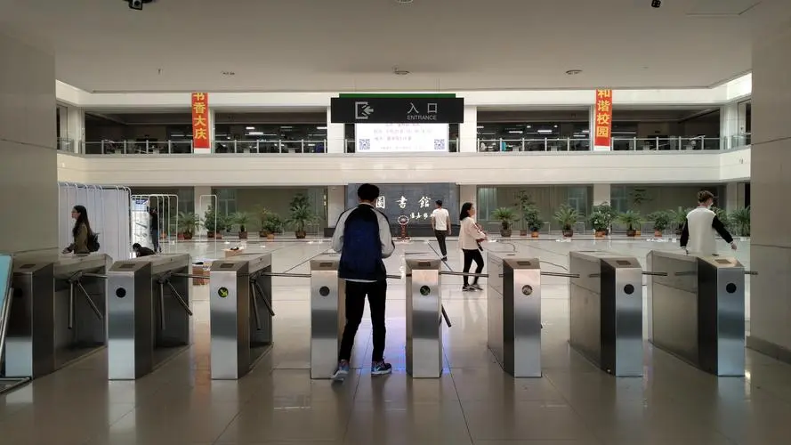
Starting point
起始点常用词汇：
起始点常用表达
We/You are here at _ _ _
Now we are standing at _ _ _
We are situated/located in _ _ _ _
You’ll find yourself in------
····
reception block、
reception(desk)、
entrance、
main entrance、
information desk/ center、
entry gate、
access[ˈækses]、
side entrance、
Tip:听到的起点比看到的起点重要
P10

Slide 12

Direction
top right corner
top left corner
at the top
on the left
on the right
bottom left corner
at the bottom
bottom right corner
Notes:
at

Slide 13
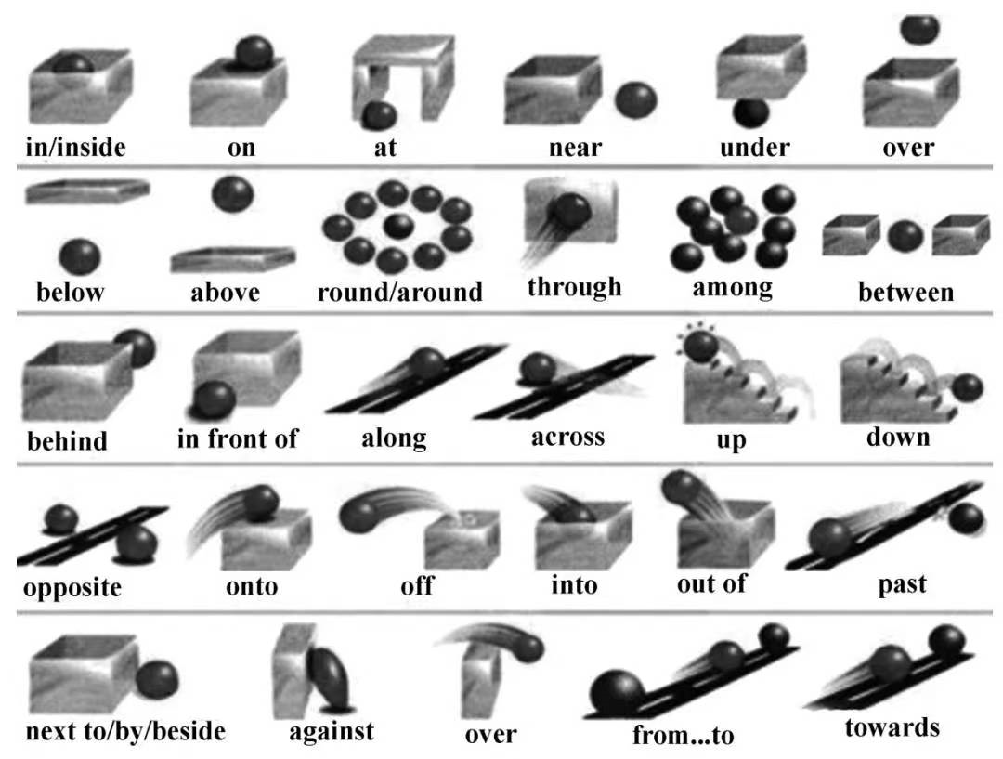
Direction

Slide 14
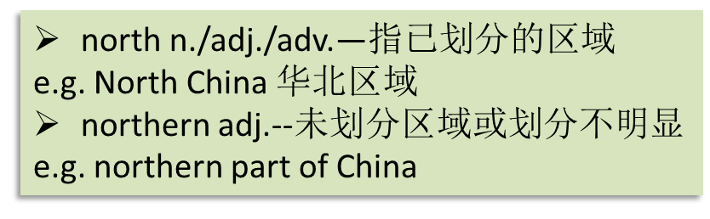
Direction
Northern
[ˈnɔːðən]
先南北后东西
northwest
northeast
Western
Eastern
[ˈwestən]
southwest
southeast
[ˈiːstən]
Southern
[ˈsʌðən]
图4

Slide 15

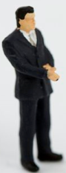
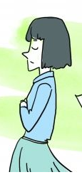
Direction
D
A
B
C
A
B
C
图 2
next to/beside/close to
near(by)/past
图 3
in front of/ ahead of
behind/ at the back of
on one side, on the other side
between … and…
in the middle
opposite/across from
facing
far away from/ on the far side

Slide 16
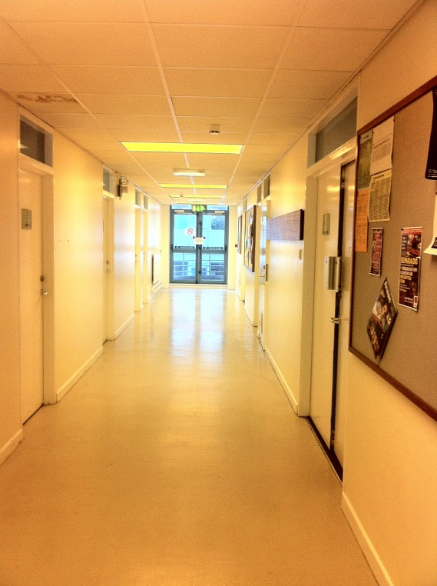
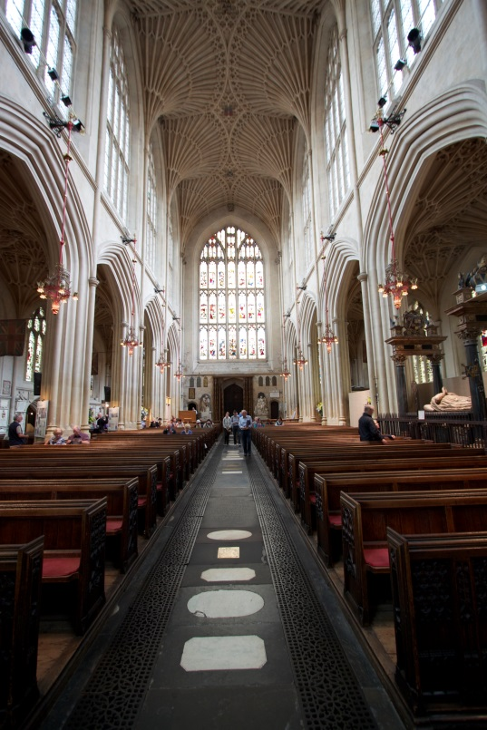
Vocabulary
常见暗线地标补充
corridor [ˈkɒrɪdɔː(r)] / passage
aisle [aɪl]
走廊、通道
走道、过道
Notes:
aisle：[aɪl] a passage between rows of seats in a church, theatre, train, etc., or between rows of shelves in a supermarket

Slide 17
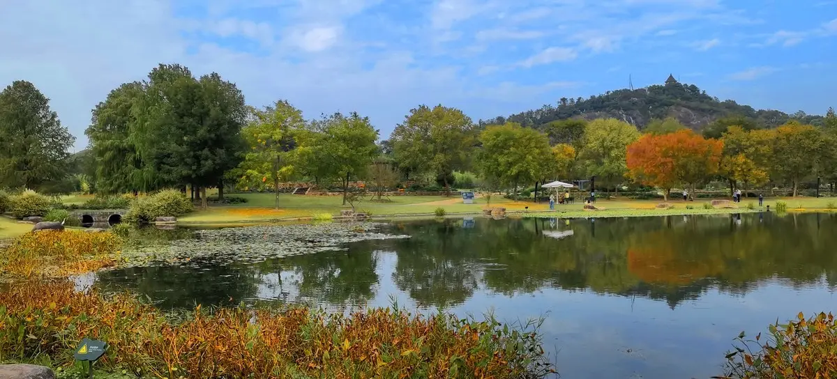
C15-T4-S2 P75
Croft Valley Park

Slide 18
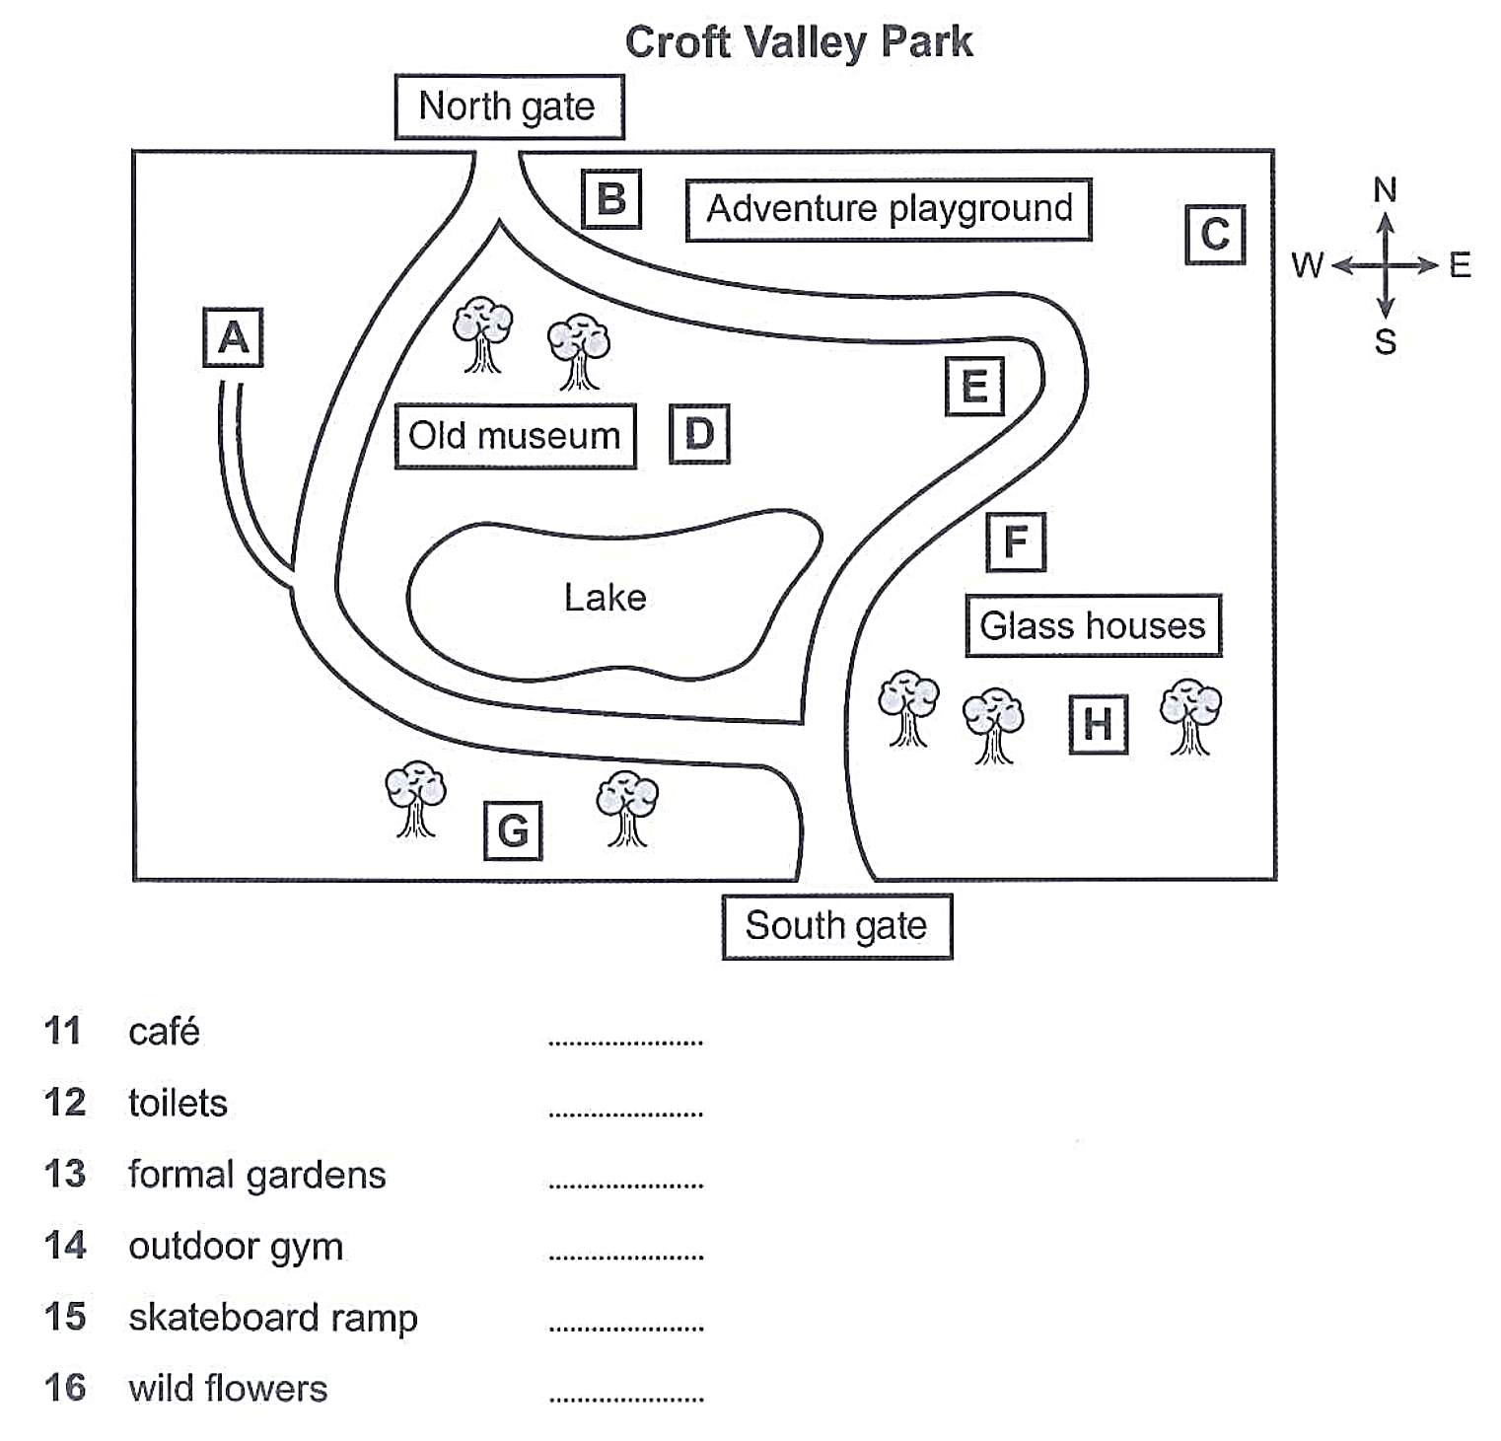
C15-T4-S2 P75
leads off

Slide 19
11. looking out over the lake, and _______the old museum.
12. ______the adventure playground. ____________of your map
13. the space ________the south gate. ________the park boundary _____the path that ____________the lake ________the old museum
14. ____the glass houses. to ______the of the path from the south gate. ______in the trees.
15. _____the old museum. ____________the little path that _________from the main path between the lake and the museum.
16. on a ______in the path that goes round the _______of the lake. _____of the adventure playground
next to
near
in the corner
near
between
and
goes past
towards
by
right
hidden
near
at the end of
D
C
leads off
G
H
bend
A
east side
south
E

Slide 20
Notes
boundary
hidden
bend
near/next to/ by
path/main path
lead off
ramp

Slide 21
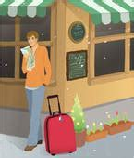
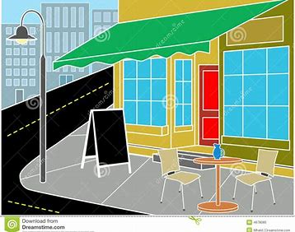
Vocabulary
常见暗线地标补充
corner
bend
角落
拐弯

Slide 22
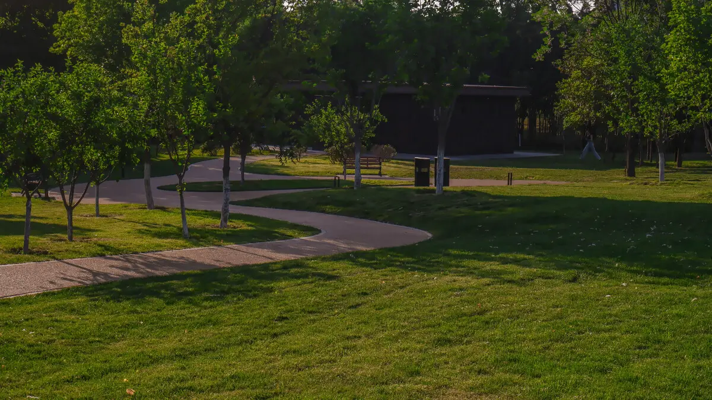
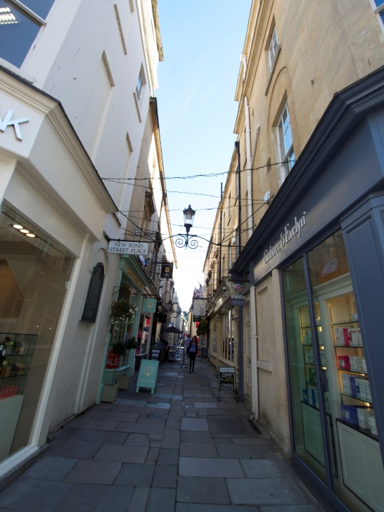
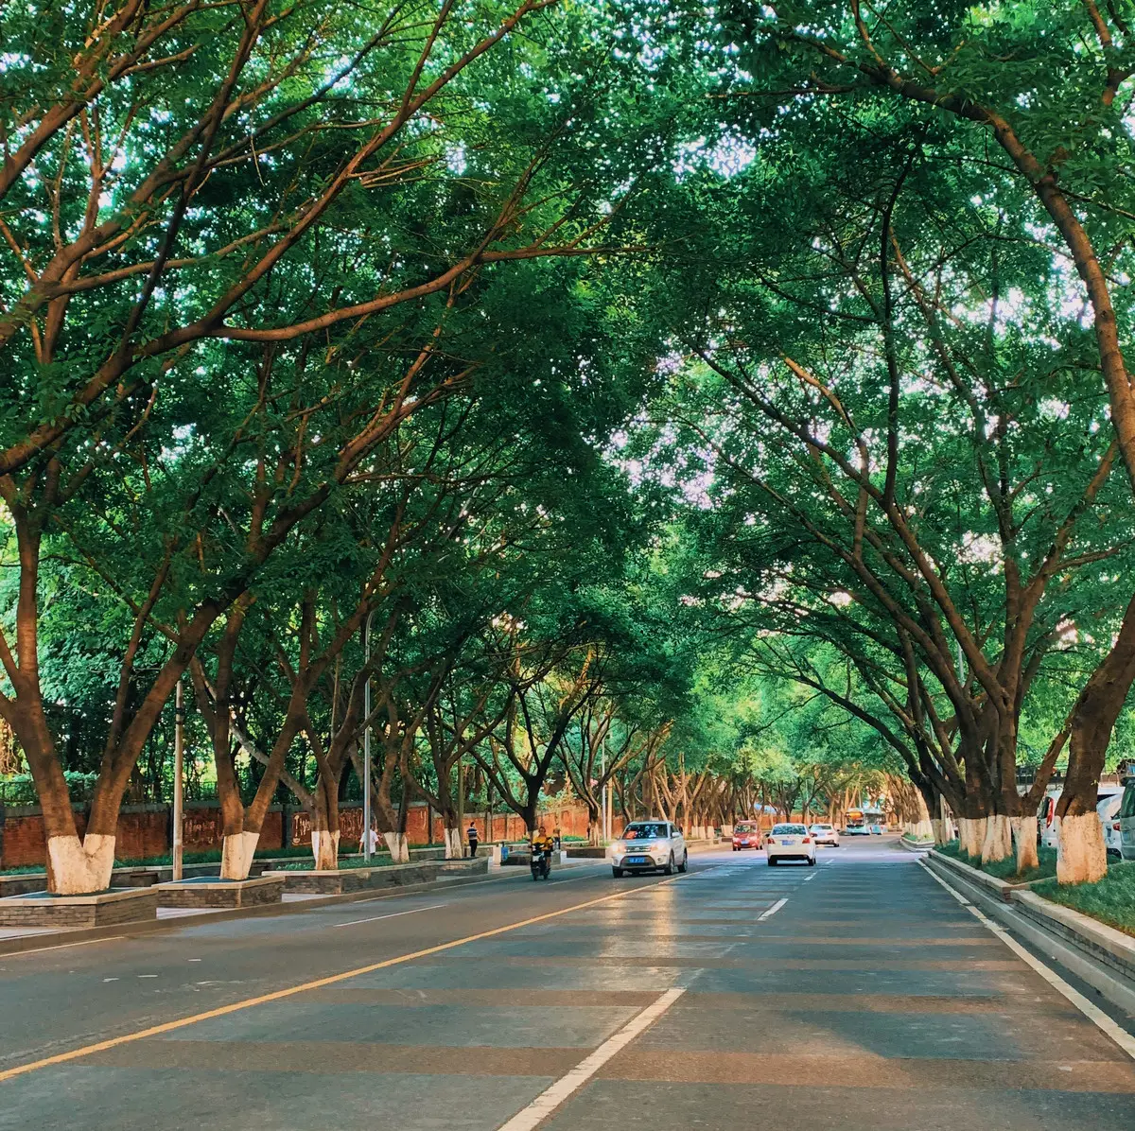
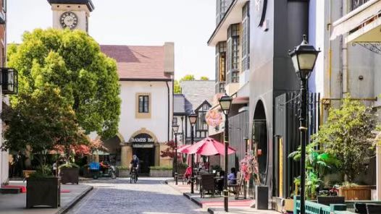
Vocabulary
常见暗线地标补充
path
alley/lane
avenue[ˈævənjuː]/
boulevard[ˈbuːləvɑːd]
street
Notes:
aisle：[aɪl] a passage between rows of seats in a church, theatre, train, etc., or between rows of shelves in a supermarket

Slide 23
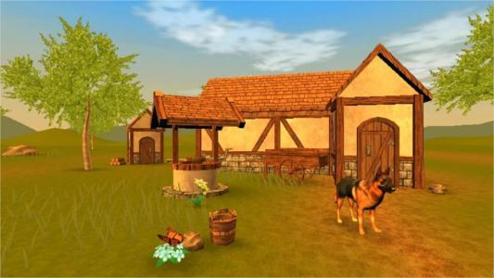
C11-T1-S2 P13
进阶练习：
Fiddy Working Heritage Farm

Slide 24
C11-T1-S2 P13
1看（SDL）
2听(方位词+地标)
3查

Slide 25
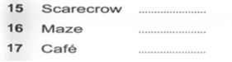
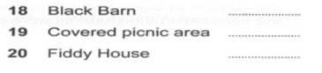
F
car park, corner, beside the main path
G
look ahead, opposite the new barn, beside the side path that branches off 分叉 to the right
D
go towards the bridge, turn right before it , walk along first bend
H
side path, right, new barn, first bend
C
near the farmyard, cross the bridge, on the right
A
cross the bridge, walk along the footpath, to the left

Slide 26
C11-T1-S2 P13
useful tips：
较复杂的地图题通常需要多点定位；
耐心原则（17+19题）
细心原则（没看到A选项？）
几个小词的辨析：
walk along:
walk towards：
walk across：
沿着···走
朝···走
穿过

Slide 27
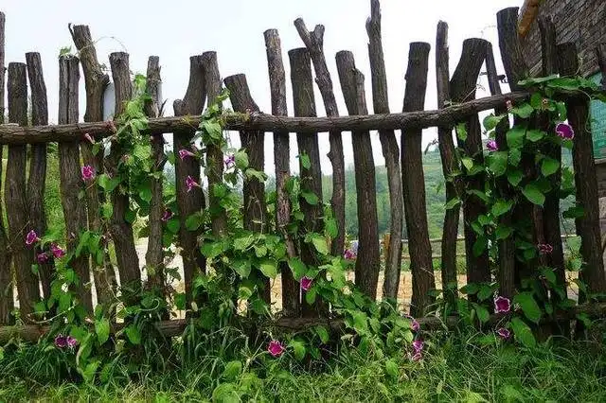
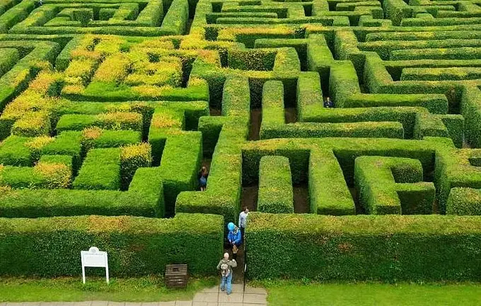
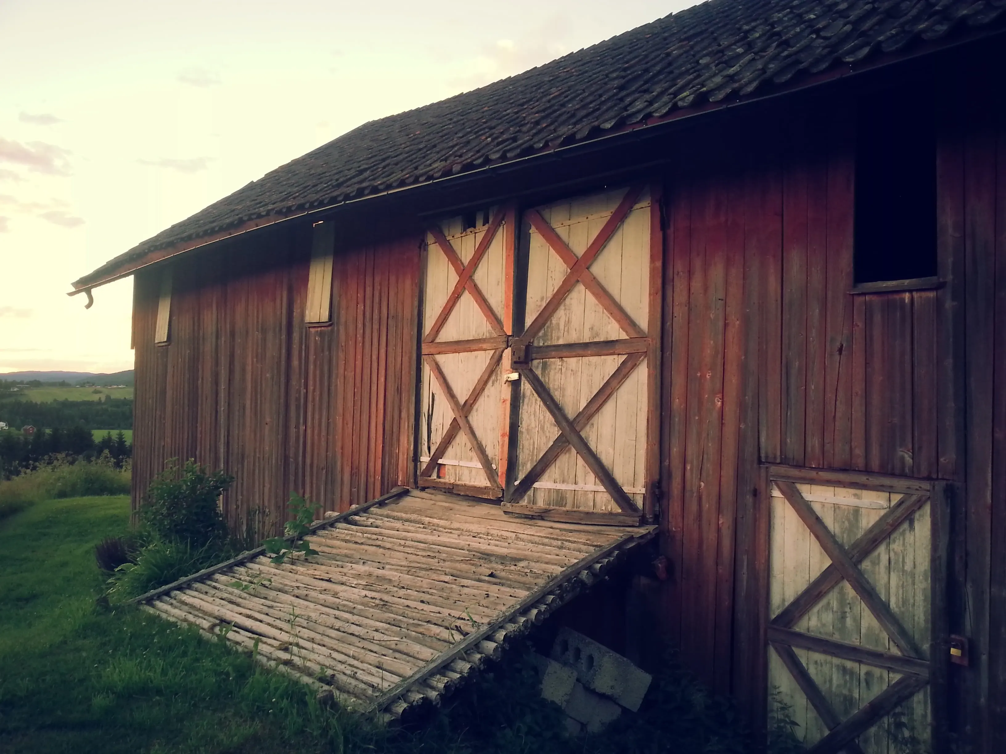
Notes
for keeping the brids away from the crops
yard
footpath、side path
maze
hedge
branch off
barn
scarecrow

Slide 28
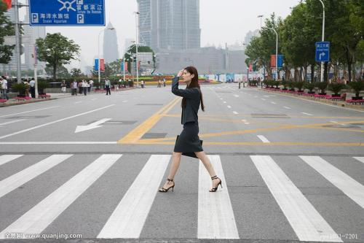
Vocabulary
pedestrain
行人
pavement
footpath
人行道
sidewalk

Slide 29
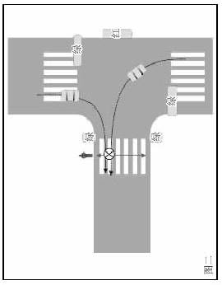
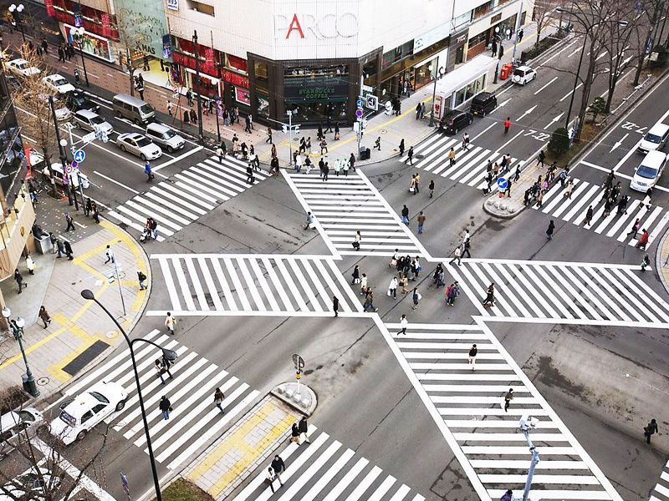
Vocabulary
intersection / crossroad/crossing
Junction
十字路口
结合处、汇合处

Slide 30
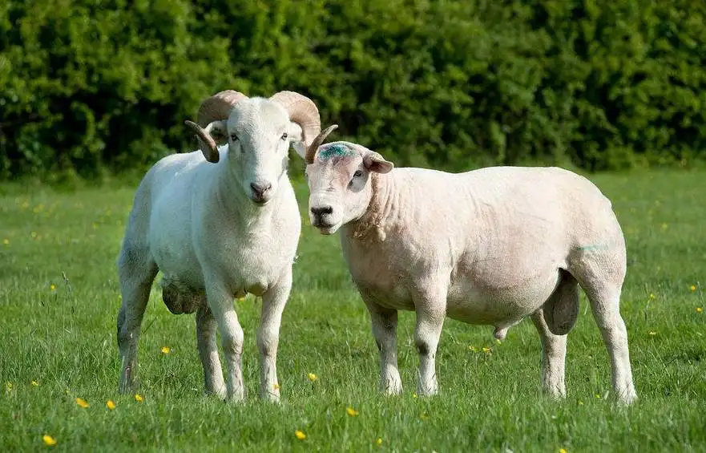
C12-T8-S2 P76
Art and History in the Sheepmarket

Slide 31
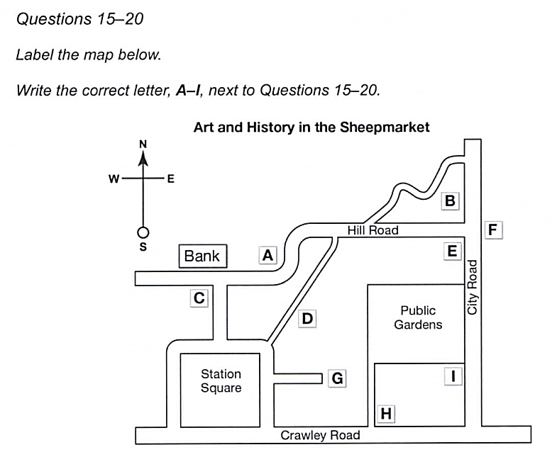
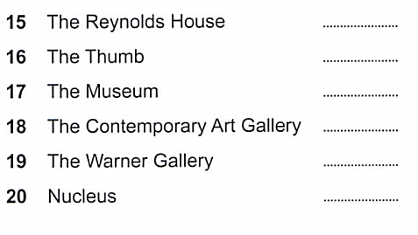
C12-T8-S2 P76

Slide 32
C12-T8-S2 P76
next to the footpath that leads to the puclic gardens
across the road from the bank
it’s on the other side of road from the public gardens, immediately facing junction of city road and hill road
on the same side on city road with public grdens
until you get to a small winding road turning off

Slide 33
C12-T8-S2 P76
H
C
F
G
I
B

Slide 34

Skill
1. 看--- Staring point
Direction（无指南针：LRTB/有指南针NSWE）
Landmark
tip:填空式按照题号顺序进行；
配对式按照一定顺序读图；
2. 听---方位词+地标，注意起点、特征词（形状/转角）
tips:答案通常出现在方位词前后
3. 查---检查单词拼写、单复数、字数要求
Notes:
地标

Slide 35


“暗线”地标
形状
小路
走廊
交叉路口
拐弯处
circular
rectangular
square
triangular
footpath
path
lane
alley
corridor
passage
hallway
aisle
intersection
junction
corner
bend

Slide 36
备选题

Slide 37
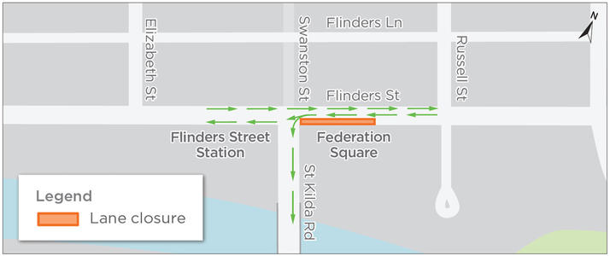
13-1-2 P12
拔高冲刺：
Proposed Traffic Changes in Granford

Slide 38
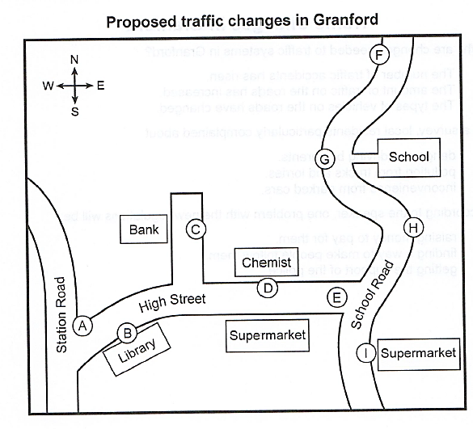
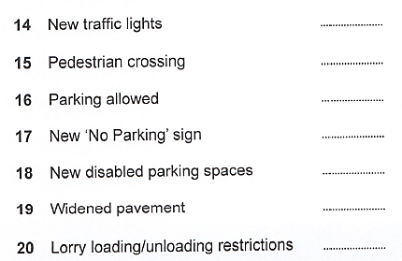
13-1-2 P12
junction
side road

Slide 39
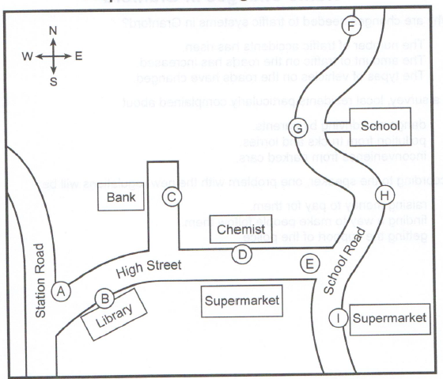
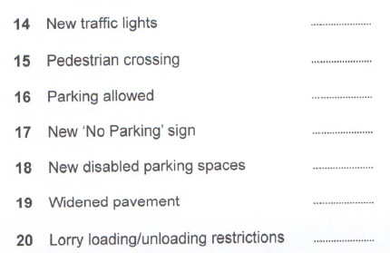
useful tips：
注意转折信号词：but
注意表示否定的词：not
注意其读法
E
other end, school road junction
D
high street, in front of supermarket
B
isn’t at high street, outside the library, change that
G
school road, by the entrance to the school
C
side road up towards the bank
H
bend, before the school, same side
I
supermarket on school road

Slide 40
Notes
traffic light
pedestrian
sign
disabled
pavement
lorry loading/ unloading restrictions

Slide 41
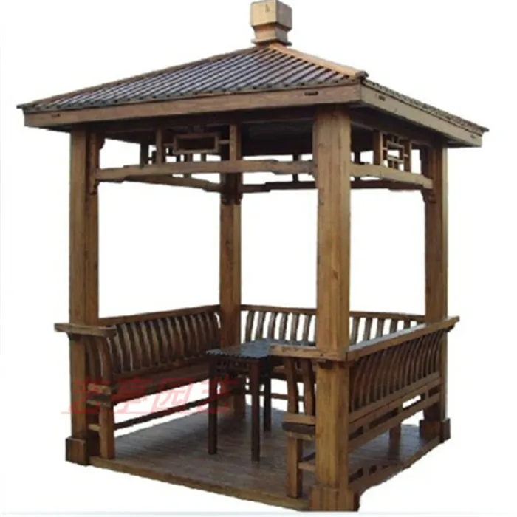
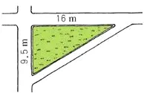
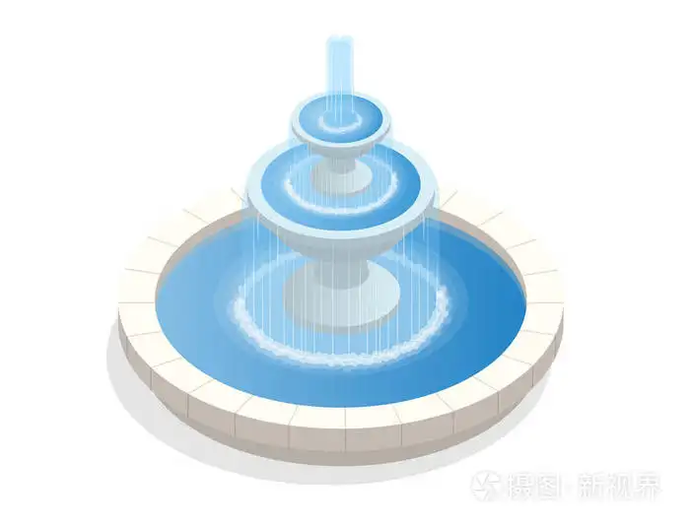
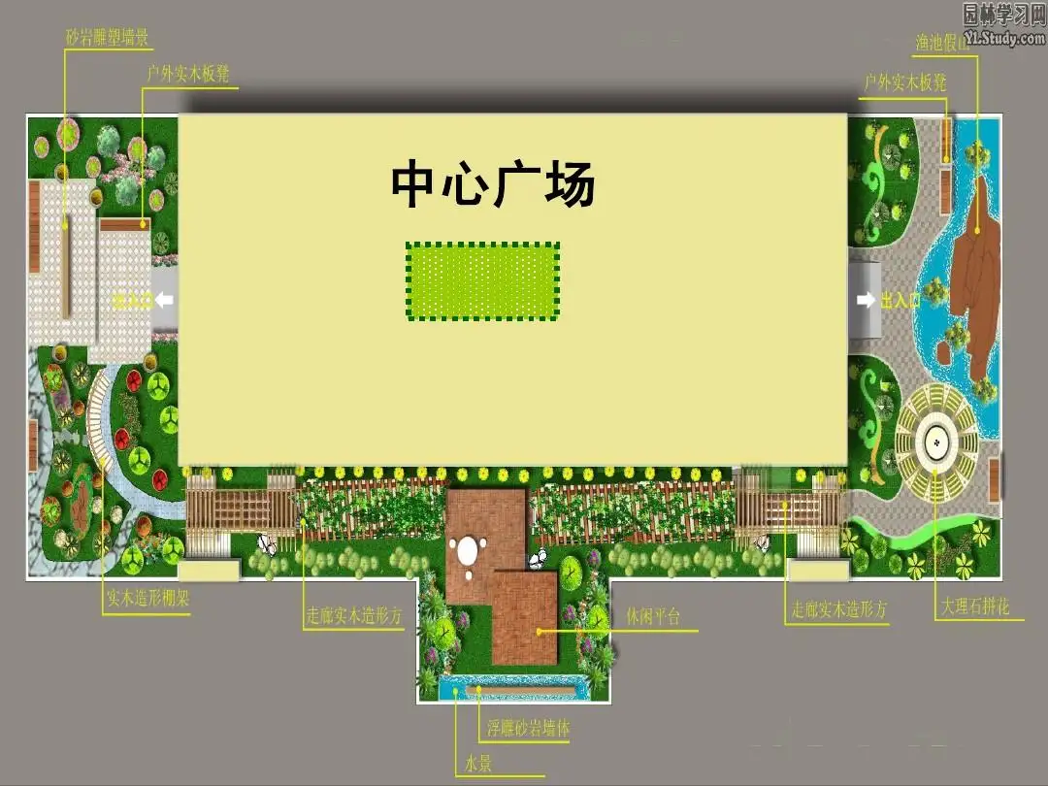
Vocabulary
square pavilion
triangular lawn
circular fountain
rectangular square

Slide 42
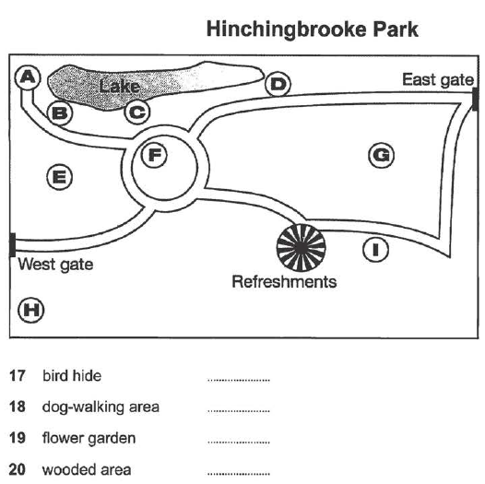
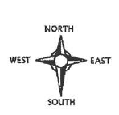
C9T2S2 P36
备选题

Slide 43
C9T2S2(P36)
A
to the west ... end of the path
I
near the refreshment，southern part of the park
F
circular area, surrounded by paths
E
western section, between two paths

Slide 44
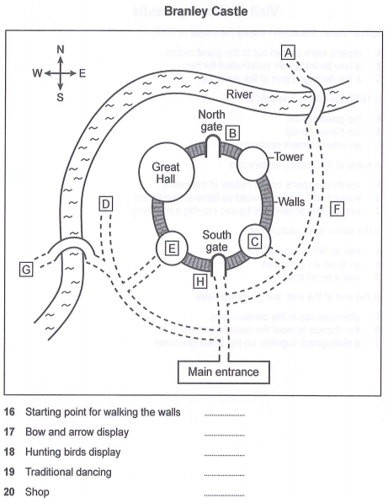
C14T2S2 P34
备选题

Slide 45
C14T2S2 P34
16. near the main entrance - walk straight down the path until you get to the south gate, and it's just there.
17. take the first left after the main entrance and follow the path past the bridge, then you'll see it in front of you at the end.
18. go from the main entrance in the direction of the south gate, but turn right before you get there instead of going through it, you'll see it on your right past the first tower.
19. on the outdoor stage. that's right at the other side of the castle from the entrance and over the bridge
20. inside one of the towers, but the way in is from the outside. just take the first left after the main entrance, go down the path and take the first right.
H
D
F
A
E

Slide 46
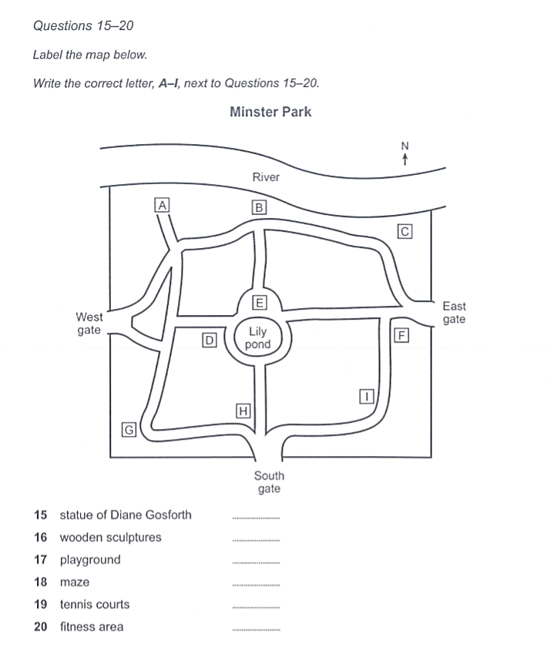
C15-T2-S2 P33
15.E: immediately to the north of the lily pond, almost in the centre of the park
16.C: on the river bank, where the path from the east gate makes a sharp bend
17.B: between the river and the path that leads from the pond to the river

Slide 47
18.A: near the west gate-you go from there towards the river and then turn left to reach it
19.G: in the south-west corner of the park,where there's a right-angle bend in the path
20.D: right next to the lily pond on the same side as the west gate

Slide 48
Homework
作业：备选题+所有地图题

